Slide 1


Slide 2
Introduction
Vemuri Agri Products is promoted by professionals having decades of experience in various industries and the Food Processing sector supplying different types of machines to process different products. Towards this end a separate company Propac Engineers was formed to cater to the manufacturing and Fabrication of machines.
We are proud to be associated with world class processing equipment made in Stainless Steel / Fiber and Nano materials that are used in transformation of Organic and Natural raw material into Eco friendly Biodegradable products. We want to reduce garbage, convert the agri waste and replace plastics with non-toxic alternatives. Make the Mother Earth do a little dance as she gets cleaned up. We want to leave the earth better for your kids, their kids, the cows, the animals, the fishes etc
In the new buzz word – Circular economy all the tableware products are made from Agri-residue. What is agri-residue? It’s simply the leftovers that used to be burned. Now, we use it to make juicy, glumpy, glorious pulp and we mold it into cutlery that is 100% disposable for a cleaner planet. But let’s start at the beginning.

Slide 3
Summary
Rice is the staple food of more than half the world. Processing of rice paddy yields large quantities of rice husk, also called the hull or chaff. Rice husk is the outermost covering layer that protects the grain of rice. As output increases, the byproducts also increase requiring environmentally friendly ways of disposal that neither occupies space or cost too much to transport, nor pollute the air.
Due its unique physical and chemical properties RH can be effectively used in domestic and industrial processing. RH has good binding ability which reduces the formation of cracks and it is used in preparing of Biodegradable pottery products. RH has been used as an industrial raw material for different purpose such as making panel boards, insulating board material, fillers in plastics, filling material, building materials etc. It is also used as a value added material for domestic and industrial processing such as preparing valuable silicon based materials, cement, as source of pet food fiber and as source of dietary fiber, preparation of activated carbon, refractory industry, polymer, rubber, preparing sorbent for waste water treatments, in bio ethanol production, to control of insect pests in stored food stuffs and Bio-Synthesis of silica Nano-particles.

Slide 4
Properties & Plan of Action
Systematic application of RH and RHA in direct manufacturing and synthesizing new materials could solve the problems of disposal and decrease the cost of waste treatments. More silica content in RH as compared to other agriculture waste materials is an important potential for directly and indirectly application in different manner, which makes it good market valuable product. Application of RH might help in increasing farm economy and rural development.
In this context, away from conventional approach of creating industrial application which are of low value or no return, we propose to develop a high value, bio degradable, climate friendly and income generating solution by converting Rice Husk into bio degradable cutlery and vessels that can attract market attention. In this pilot project we are proposing to create a Enterprise Development model by which we can train local unemployed youth and entrepreneurs to take up an income generating activity and create clusters of enterprises in the Rice Husk availability regions of Egypt. We are proposing 5 such locations as part of the pilot project and establish two unit per location that will house a total of 10 manufacturing machines. The Pilot Project will also address the sustainability part of the project by creating a viable business model and business plan for any on to take up this activity during the implementation. We hope to handover the project to ASRT upon completion as a Ready to Scale model across Egypt.

Slide 5
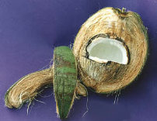
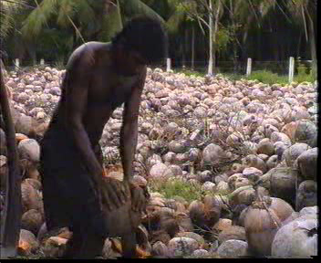
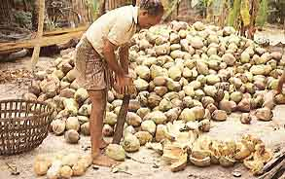

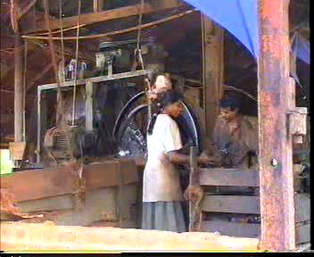
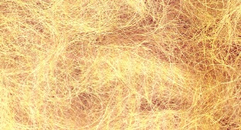
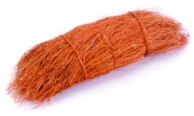
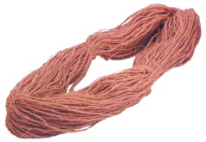
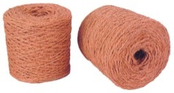
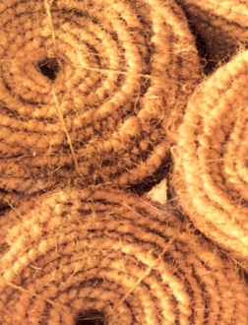

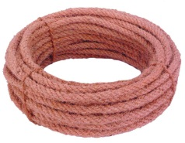
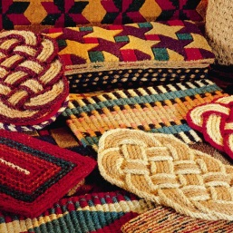
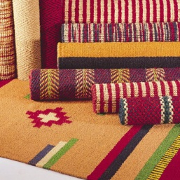
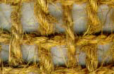

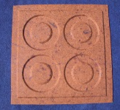
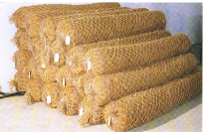

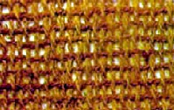
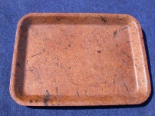
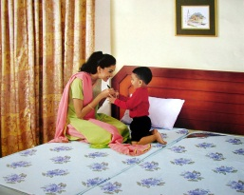
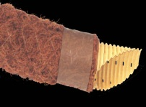
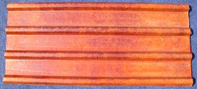
All type of Husk of H
GREEN HUSK
DRY HUSK
NATURAL RETTING
SOAKING/MECH EXTRACTION
WHITE FIBRE
BROWN FIBRE
YARN
- MAT
MATS
MATTINGS
GEOTEXTILES
ROPES
COCOLOGS
MATTRESSES
COMPOSITES
FIBRE DRAINS

Slide 6
REFERENCESOF SIMILAR RESEARCH PROJECTS BY VEMURI AGRI PRODUCTS
Hyderabad, India – Urban Garden Articles like Horticulture Pots from Coconut Coir.
Our motto is “Save Mother Earth” and that generated the idea of converting Coconut Husk or Fiber into a sustainable livelihood model for entrepreneurs and small stakeholders by developing an economical cost effective innovative machine automation and systems. We developed a unique Hydraulic based system moulding machine that creates various articles like Garden Pots / Hanging Baskets / Trays from Coconut Fiber / Banana fiber with complete solution of machine and technology knowhow as a turnkey project.

Slide 7
Project Manager: Mr. Vittal Vemuri,
Hyderabad & Coimbatore, on Jute Fiber based Garden Articles like Pots development.
When we extract Fiber through a manual extraction process we get fine fiber from Coconut / Jute husk which is 1/3 fiber and 2/3 pith. There are different ways to extract the fiber and with a mix of Binding agents we can manufacture Jute fiber sheets of varying thickness. These sheets are then treated and with the help of our machines molded into different garden articles like Pots / Hanging Baskets etc. A ideal alternative to plastic garden pots.
Project Manager: Mr. Giri Vasan
Coimbatore, India – Tableware and cutlery from Areca Leaves.
Mr. Giri had developed the Areca leaf sheath cutlery and tableware technology in 1999 and successfully commercialized it usage. More than 1000 entrepreneurs are using our innovative machines and technology knowhow, provided as a turnkey project for their business model in converting and transforming agricultural waste into value added Eco friendly products such as cups, plates, spoons and bowls. These products being biodegradable provide more convenience and are easy to dispose after use while on vacations, family outings and functions.
Project Manager: Mr. Giri Vasan
Coimbatore, India – Articles from Banana fibre / Pineapple waste

Slide 8


VEMURI AGRI PRODUCTS
.

Slide 9
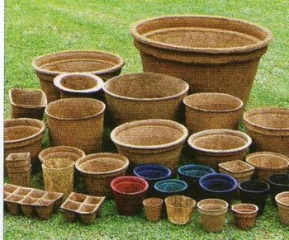
Products – Coconut /Jute Fibre Pots.

Slide 10
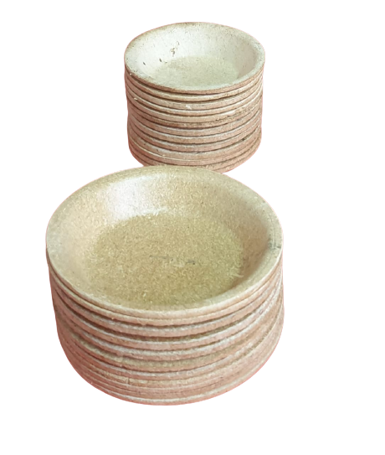
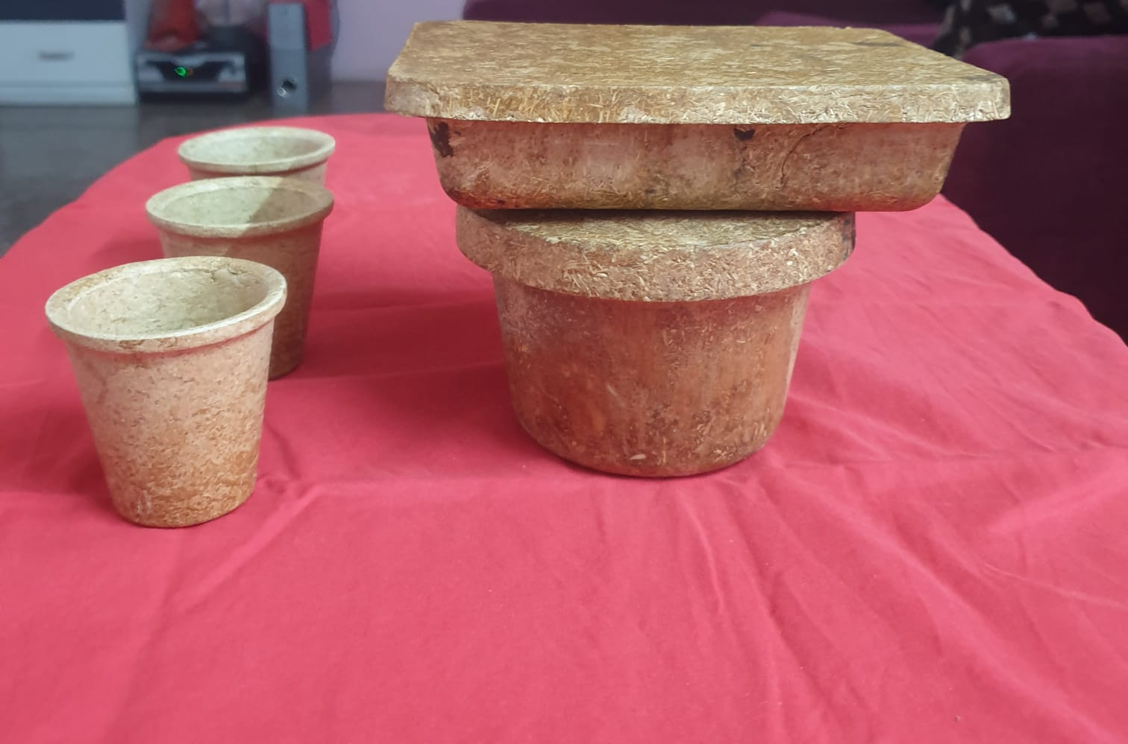
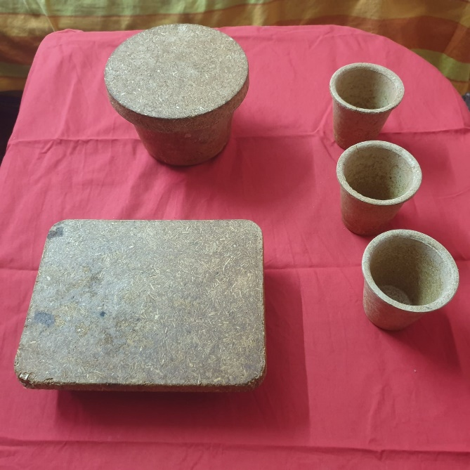
Cutlery made from Rice Husk
Rice husk cutlery can be used, such as in restaurants, catering, and events.
Highlight that rice husk cutlery can be customized with different colors and shapes to fit specific needs.
Here is the some of the samples.

Slide 11
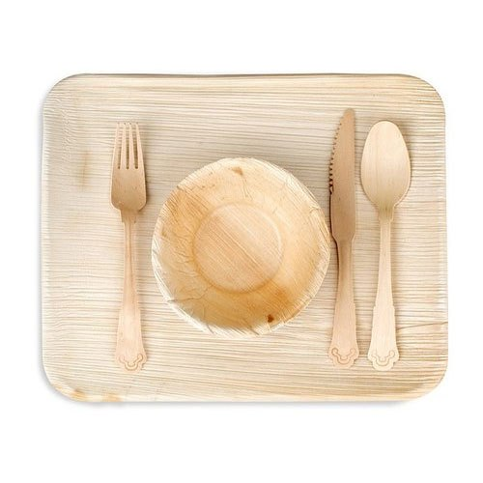
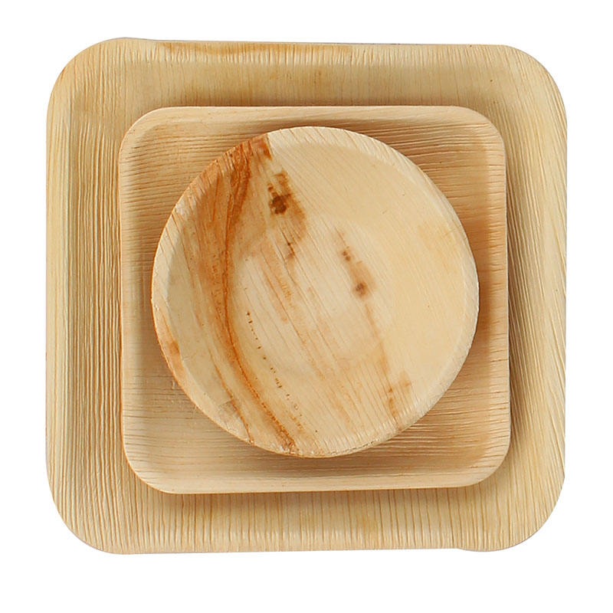
Areca Leaf made
Eco-friendly disposable plates made from fallen areca palm leaves, a sustainable alternative to plastic.

Slide 12
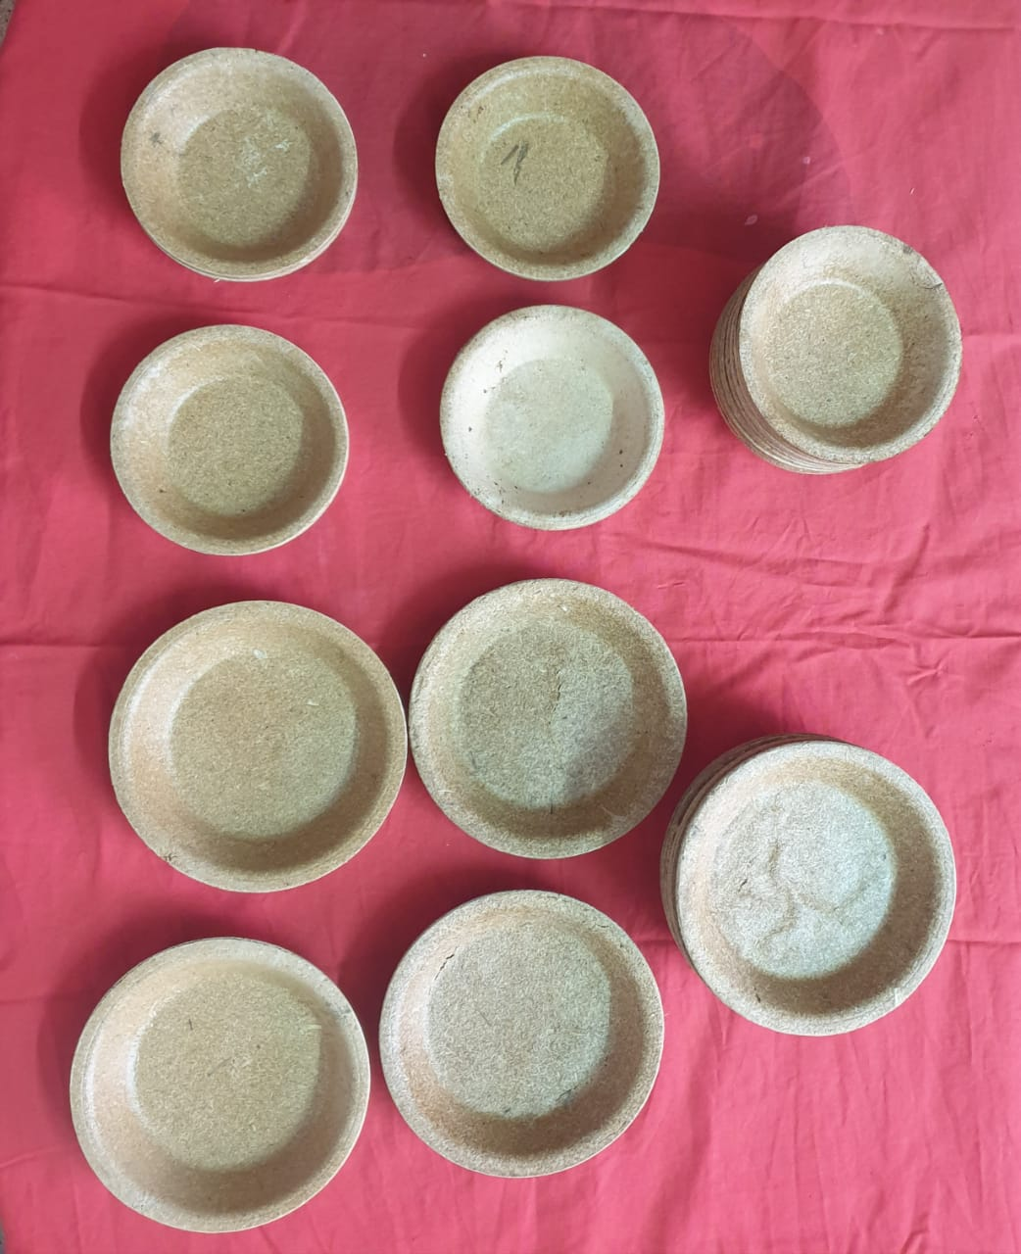
From Rice Husk

Slide 13
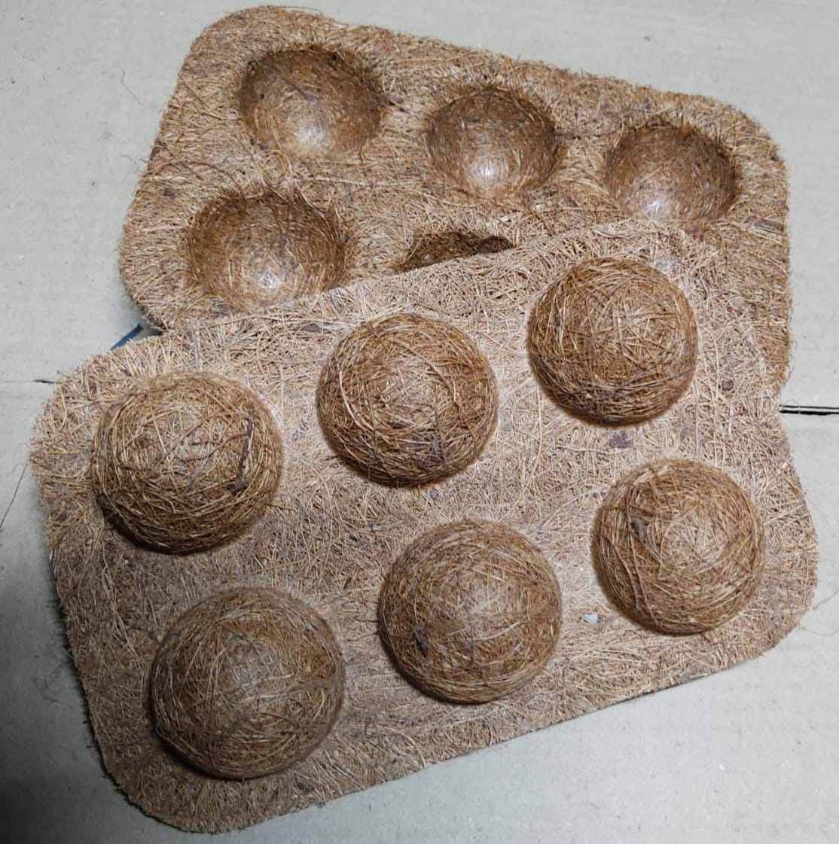
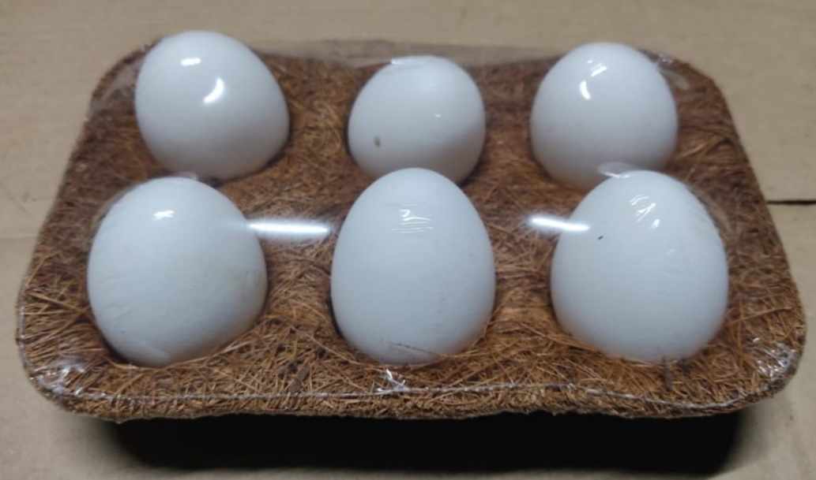
Egg tray made from Coconut / Jute fibre

Slide 14
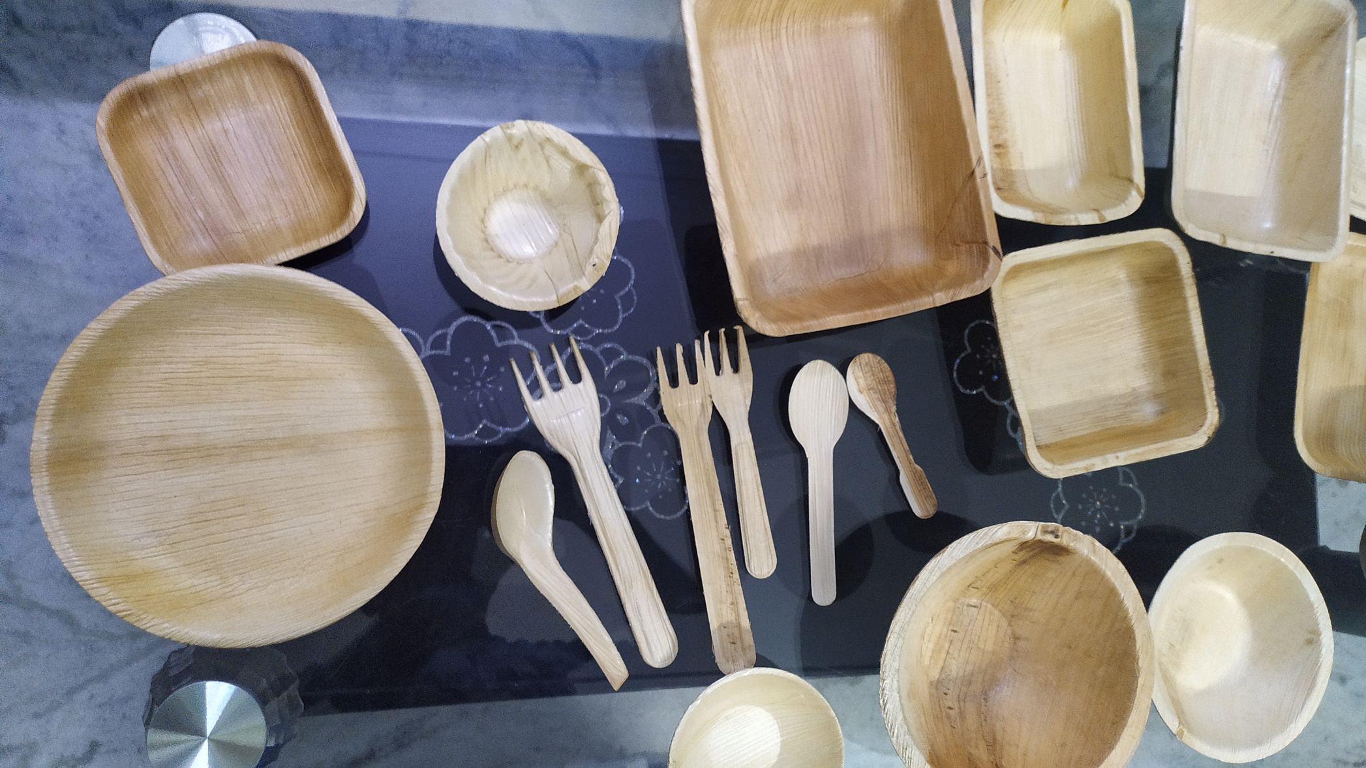

Slide 15
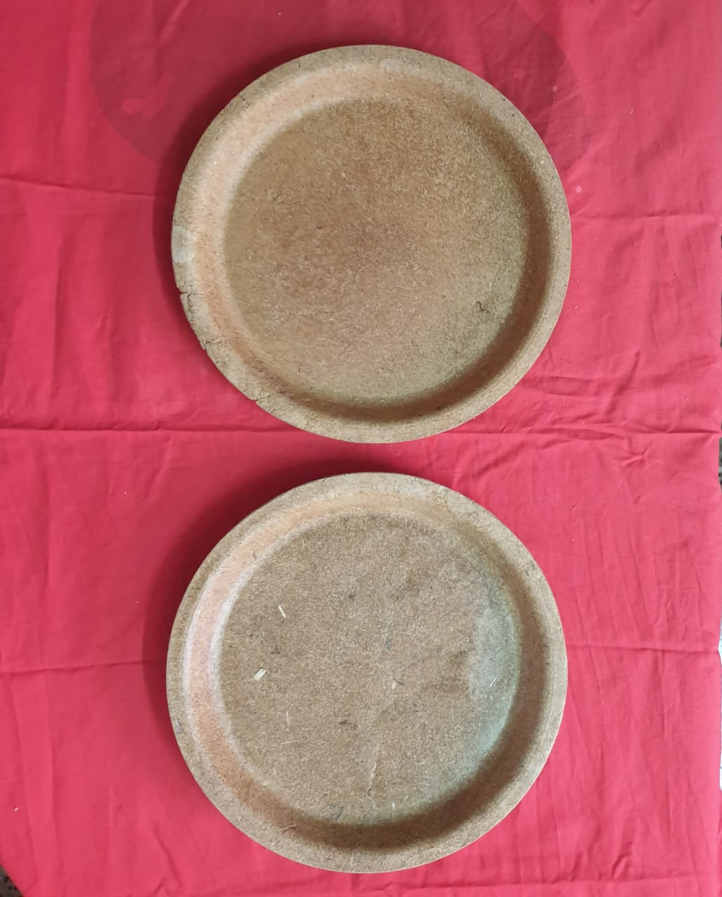
Eating Plates made from Rice Husk

Slide 16
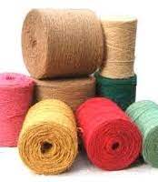
Woven Geo Textiles

Slide 17
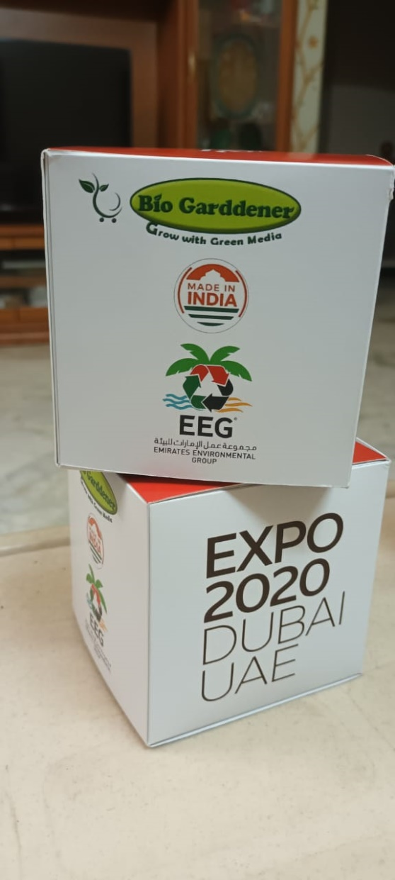

Exports

Slide 18
Food Processing Services – Machinery
Fruits – Projects for Ready To Eat and Ready To Drink products
Jackfruit – Jackfruit Powder.
Banana Powder.
Juices.
Tomato paste.
Small Dairy Farm.
Extruded Products
Bio degradable Disposable transforming Machinery.
Fiber Extraction from Agri Waste.

Slide 19
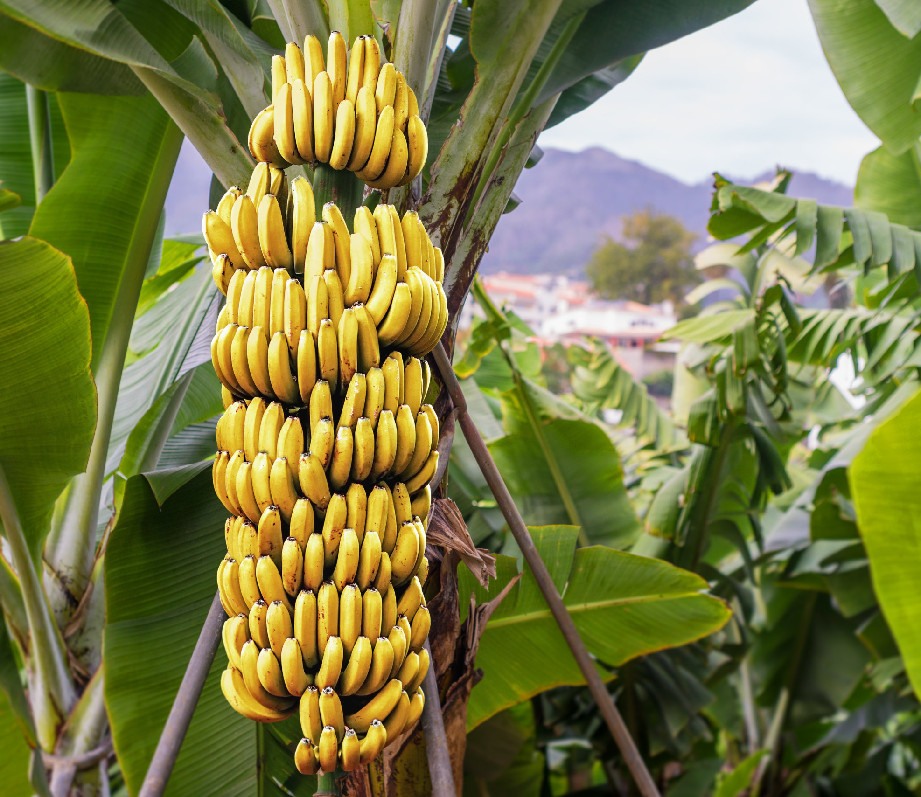
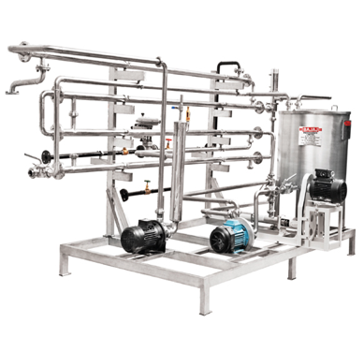
Banana Puree

Slide 20
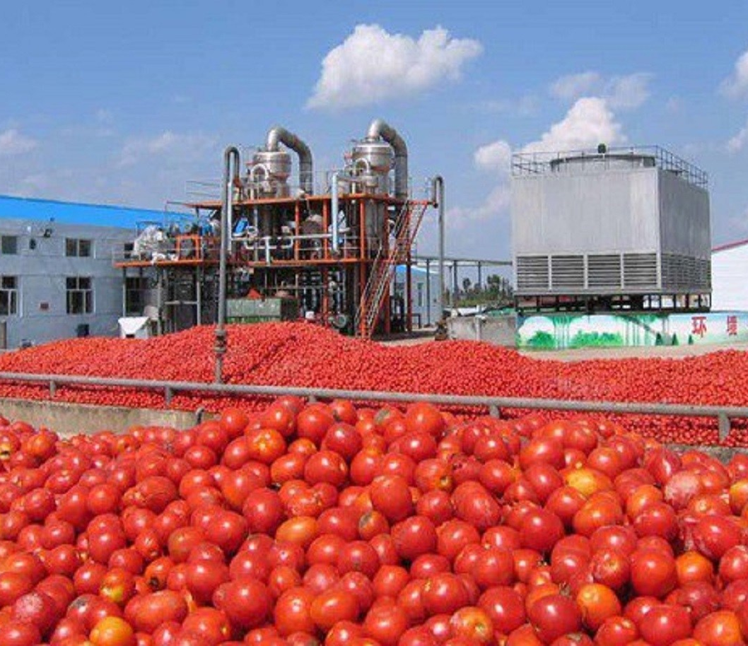
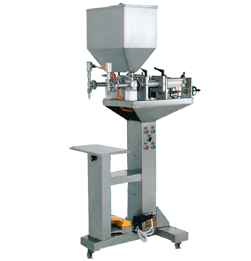
Tomato

Slide 21
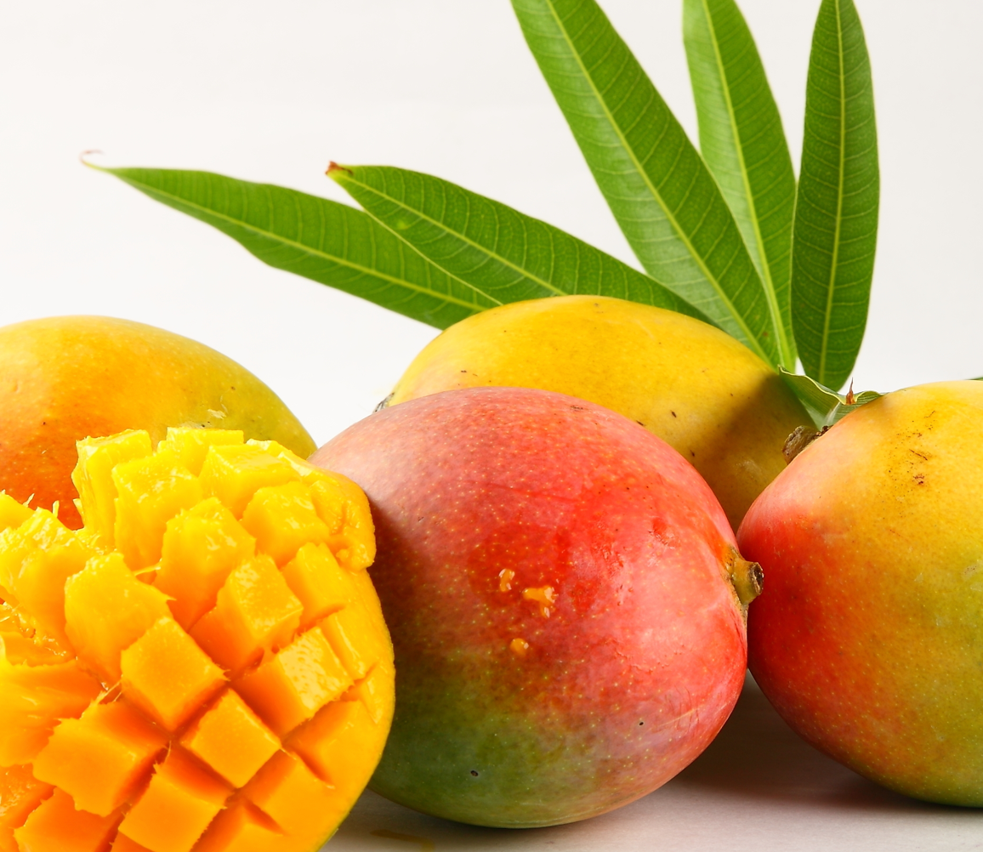
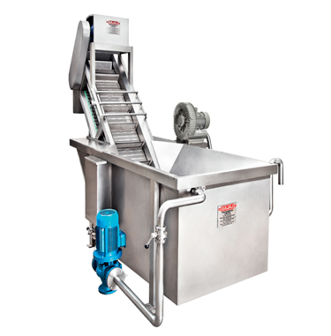
Mango

Slide 22
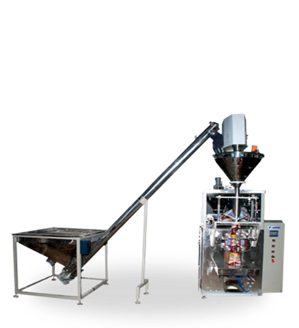
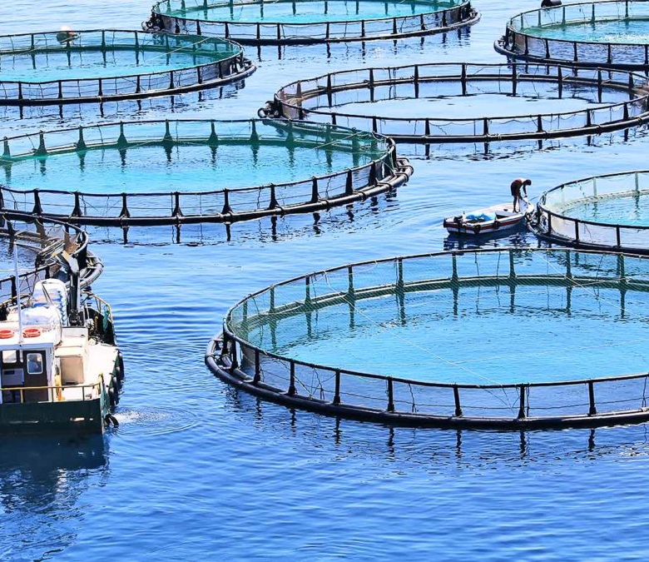
Filling & Packaging

Slide 23
CONTACT US
Website: www.vemuriagriproducts.com
Email – info@vemuriagriproducts.com
Mob - +91 9394742416
+91 9908215282
+91 7994127122
Corporate Address: 6-3-630/1/2/3,Ram Sai Symphony Dwellings
Flat # 36, Anandnagar Khairthabad
Hyderabad Telangana 500004, India

Slide 24
THANK YOU

